Slide 1
Access Denied
Keeping yourself off an attacker’s radar
Paul Gilzow gilzow@missouri.edu Twitter: @gilzow Facebook: https://fb.com/gilzow https://www.linkedin.com/in/gilzow
Notes:
How many manage people who admin/maintain wordpress sites?
How many directly admin wordpress sites?
Develop your own themes and plugins
How many are familiar with OWASP top 10?
How many use Apache? Nginx?
learned the hard way
sincere hope
apologize for jumping back and forth out of the presentation

Slide 2
a little about me
With the University of Missouri since 2000
Programmer/Analyst since 2005
Developing WordPress sites since 2009
Maintainer and current author of the wpDirAuth plugin
Author and maintainer of a MizzouMVC, a rapid-theme-development framework

Slide 3
who i’m not
Security Expert
Professional Hacker
Notes:
show what information wordpress freely gives away about itself
show how easy it can be to take control of a WordPress site
Everything we’ll cover is widely available on the Internet, and easily findable
Important to remember that we learn today might not be relevant a year from now

Slide 4
What we will talk about
Why WordPress is an attractive target
Why Education is an attractive target
Current state of web application security
Tools available
WPScan
Counter-measures
Notes:
Why WordPress is an attractive target
Why Education is an attractive target
Current state of web application security
Tools available
WPScan
Counter-measures
show what information wordpress freely gives away about itself
show how easy it can be to take control of a WordPress site
Everything we’ll cover is widely available on the Internet, and easily findable
no special skills, no ski mask
One layer, defense-in-depth

Slide 5
Types of Attacks
Opportunistic
Targeted
Notes:
opportunistic not targeting you, just low hanging fruit
opportunistic noisier
targeted stealthy

Slide 6
Why wordpress is an attractive target
Market share
Open Source
Anyone can create and submit a theme/plugin
Extremely easy to set up and get running, not so easy to secure
Notes:
Market share
Open Source
Anyone can create and submit a theme/plugin
Extremely easy to set up and get running, not so easy to secure
With popularity, comes a price.
Economic return for attacking wordpress.

Slide 7
“What makes WordPress so insecure is that it's highly extensible and easy to use; wordpress security issues revolve almost entirely around this extensibility and easyness of use.”
Tony Perez, @perezbox

Slide 8

Why Education is an attractive target
Network capacity and availability
Rich in hardware infrastructure
Poor in human resources
Resistant to blacklisting
SEO reputation
Personally Identifiable Information (PII) / Sensitive Personal Information (SPI)
Confidential Research Data / Proprietary Intellectual Property
Notes:
Network bandwidth and availability
Rich in hardware infrastructure
Poor in human resources
Resistant to blacklisting
SEO reputation
Personally Identifiable Information (PII) / Sensitive Personal Information (SPI)
Attackers aren’t targeting you, they’re targeting the resources your site has access to

Slide 9
Current State of Web Application security
Education, 49% of sites had at least one vulnerability every day of the year¹
Education, average of 28 vulnerabilities per site, 15 of those serious¹
Education, took an average of 4 months to remediate issues¹
1 - White Hat Security Web Applications Security Statistics Report 2016
Notes:
Education, 49% of sites had at least one vulnerability every day of the year2
Education, average of 28 vulnerabilities per site, 15 of those serious2
Education, took an average of 133 days to remediate issues2
As an owner/maintainer of a wordpress site, it is your responsibility to be paranoid

Slide 10
current state of wordpress security
Most compromises occur through
vulnerable plugins and themes
Weak passwords
Wordpress out-of-date
Notes:
Most compromises occur through
vulnerable plugins and themes
Weak passwords
Wordpress out-of-date
Vulnerability categories
Injections
Remote File Inclusion and/or Execution
Brute force and/or dictionary attacks
biggest issue is education and awareness
better about removing vul plugins from repo, still have work to do on verifying fixes

Slide 11
As an owner/maintainer of a wordpress site, it is your responsibility to be paranoid

Slide 12
So What DO we DO?

Slide 13
Available Tools
BuiltWith.com
Wappalyzer (Firefox, Chrome, Opera + bookmarklet)
CMSmap : https://github.com/dionach/CMSmap
Droopescan : https://github.com/droope/droopescan
Recon-NG https://bitbucket.org/LaNMaSteR53/recon-ng
WPScan : http://wpscan.org/
Notes:
BuiltWith.com
Wappalyzer (Firefox, Chrome, Opera + bookmarklet)
CMSmap : https://github.com/dionach/CMSmap
Droopescan : https://github.com/droope/droopescan
WPScan : http://wpscan.org/
Mention passive mode and bring up the next slide THEN scan wpcampus.org

Slide 14
WPScan
Passive Scan
Robots.txt
Interesting headers
Multisite
Must-use plugins
Xml-rpc
Wordpress version
Plugins/themes
Notes:
Passive Scan
Robots.txt
Interesting headers
Multisite
Must-use plugins
Xml-rpc
Wordpress version
Plugins/themes
passive mode will look like any regular user browsing the site
Scan wpcampus.org first
Mention false positives, humans always needed
log in to vagrantpress.dev, show users, themes, plugins THEN LOG OUT!
then scan vagrantpress.dev

Slide 15
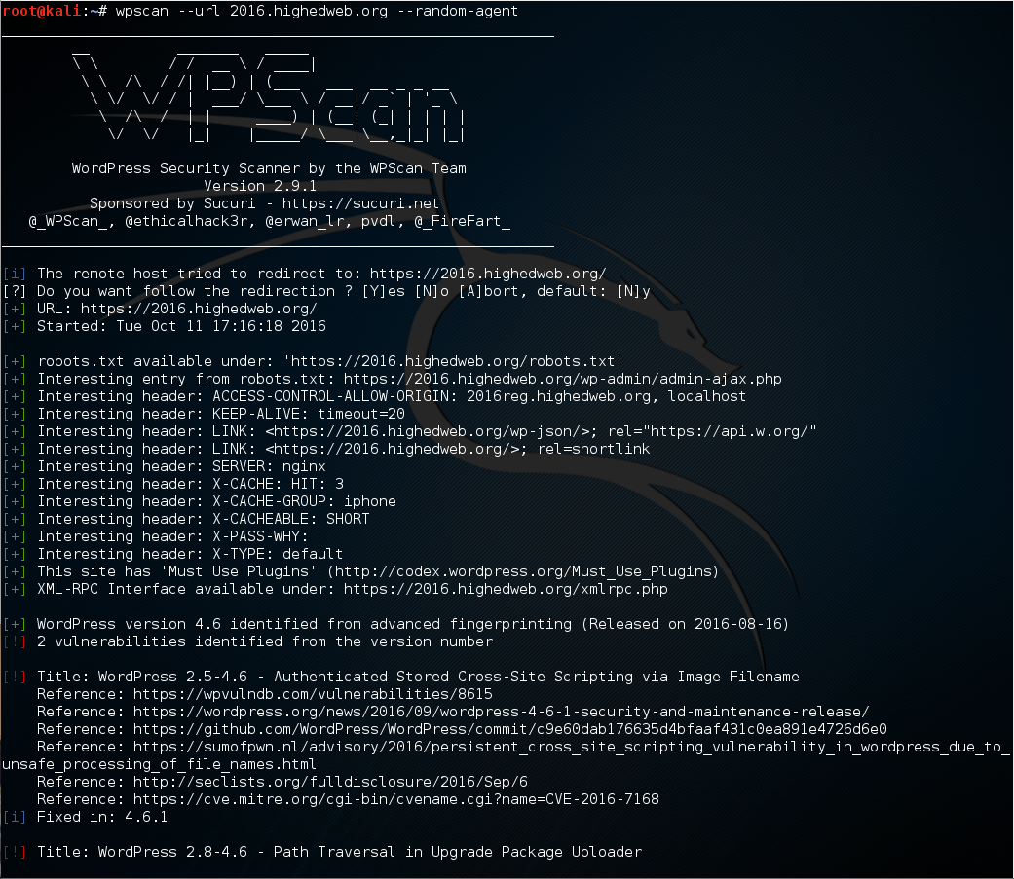

Slide 16
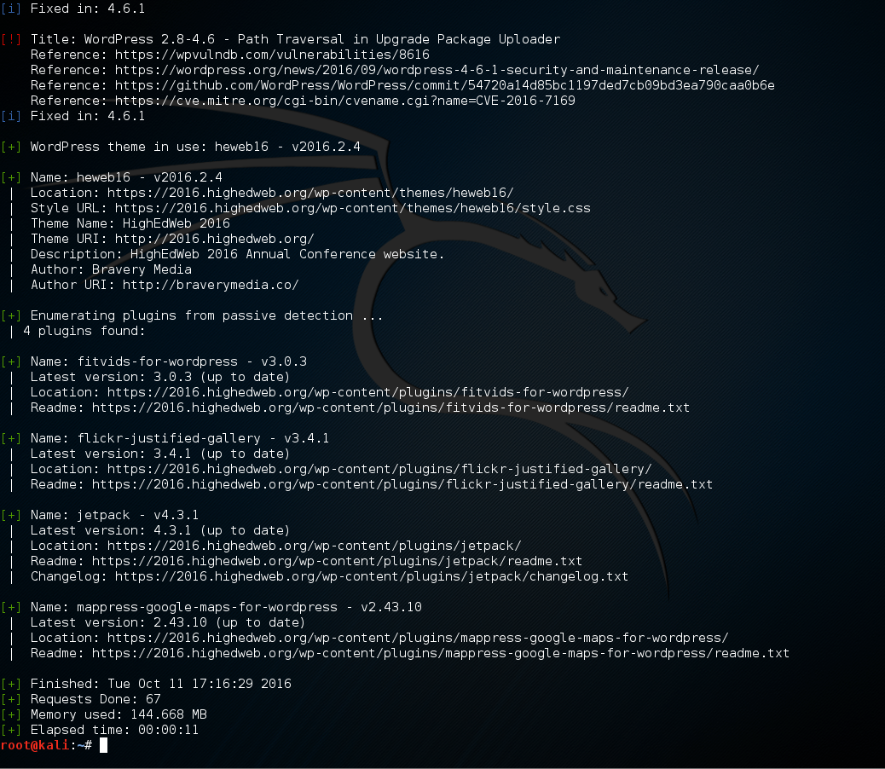

Slide 17
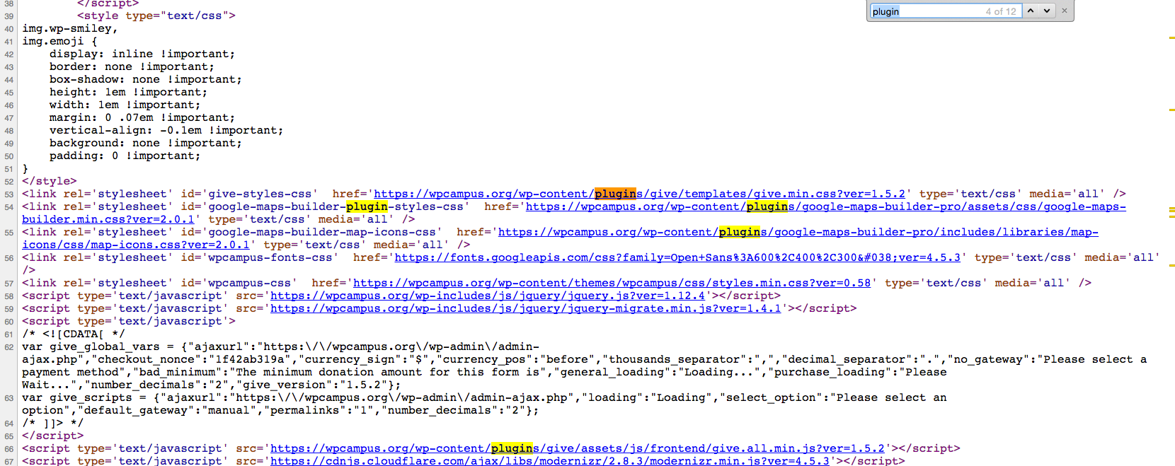

Slide 19
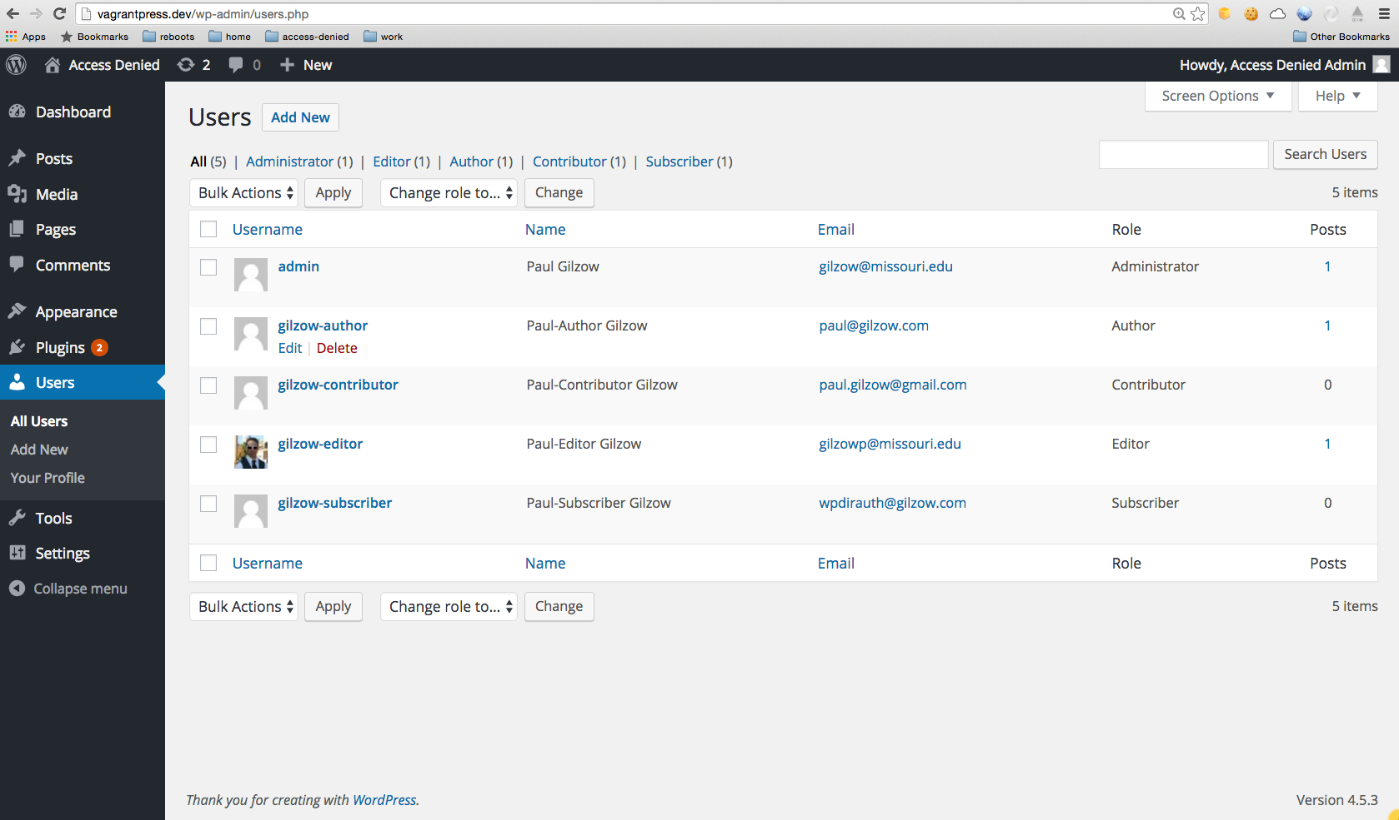

Slide 20
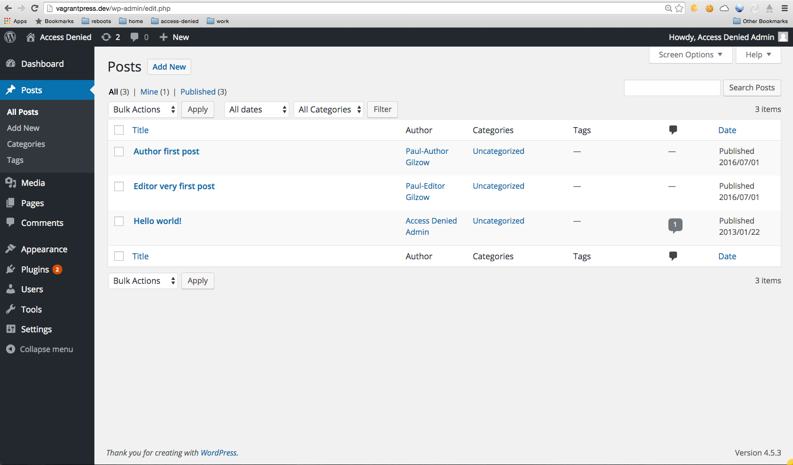

Slide 21
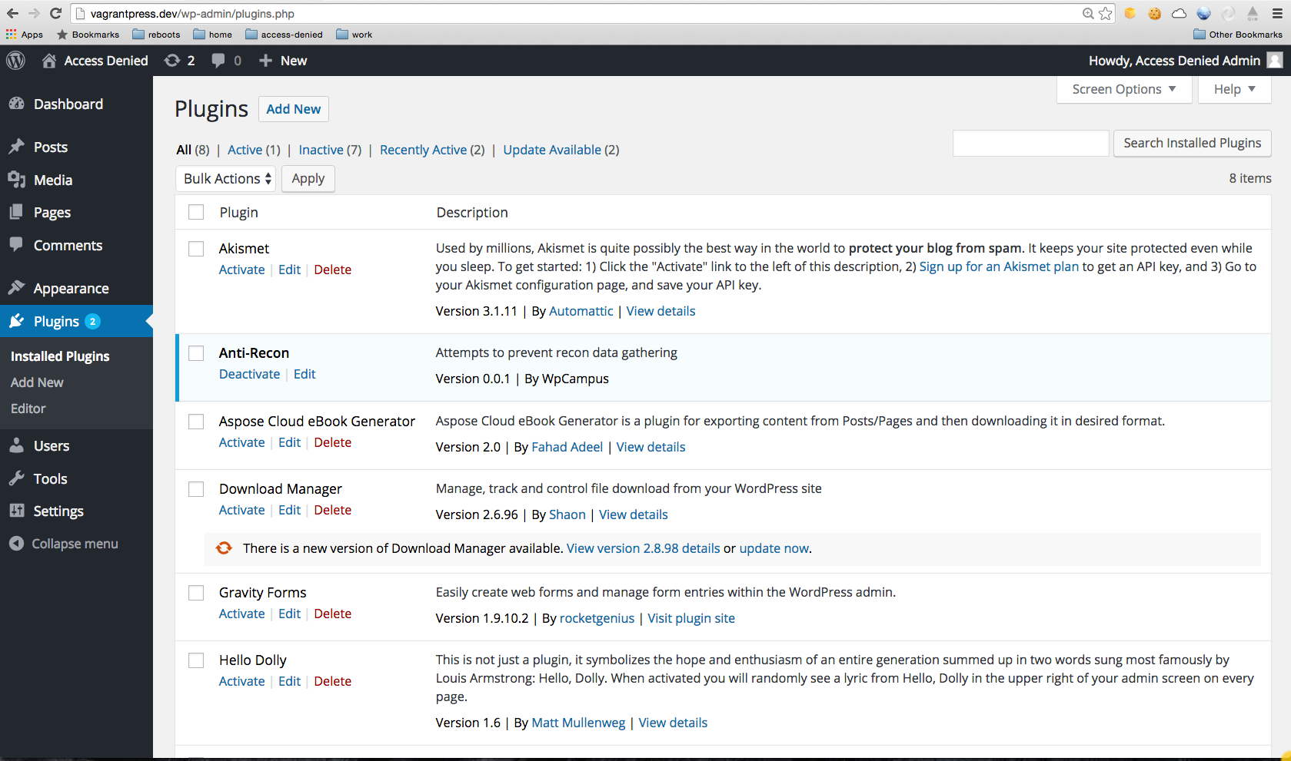



Slide 22
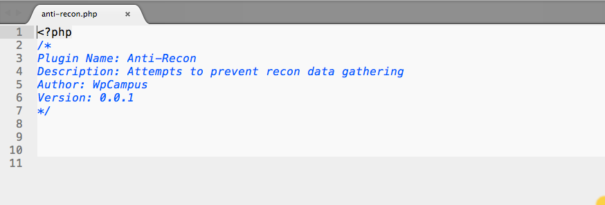

Slide 24

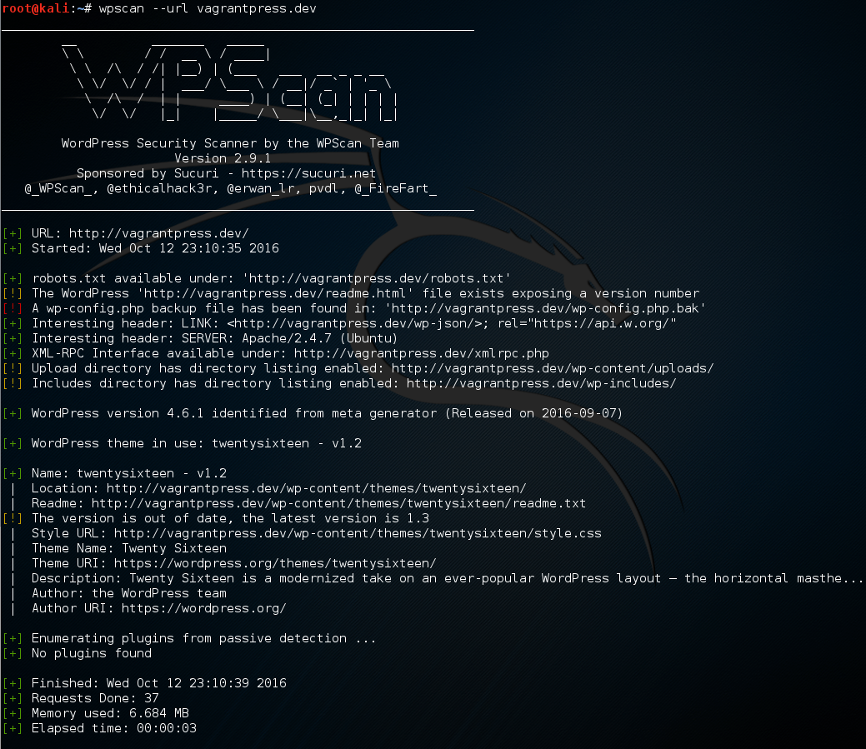

Slide 25
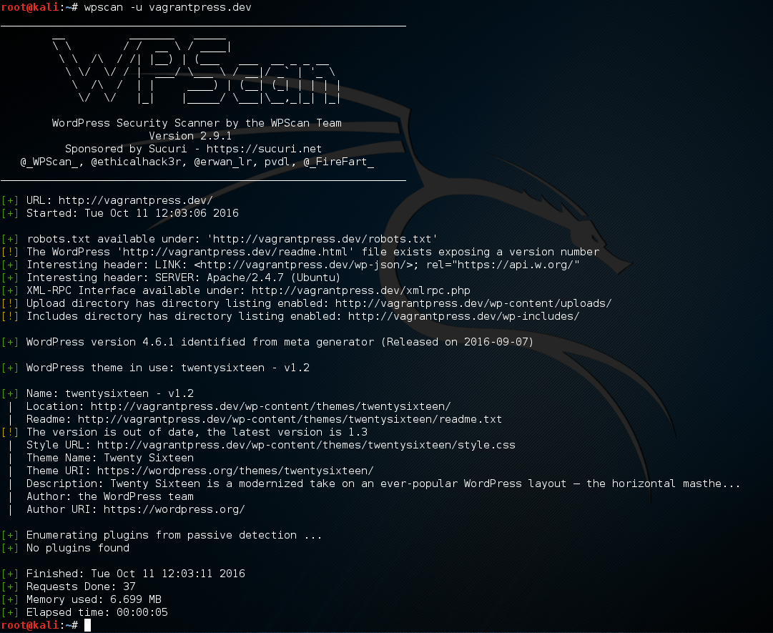

Slide 26
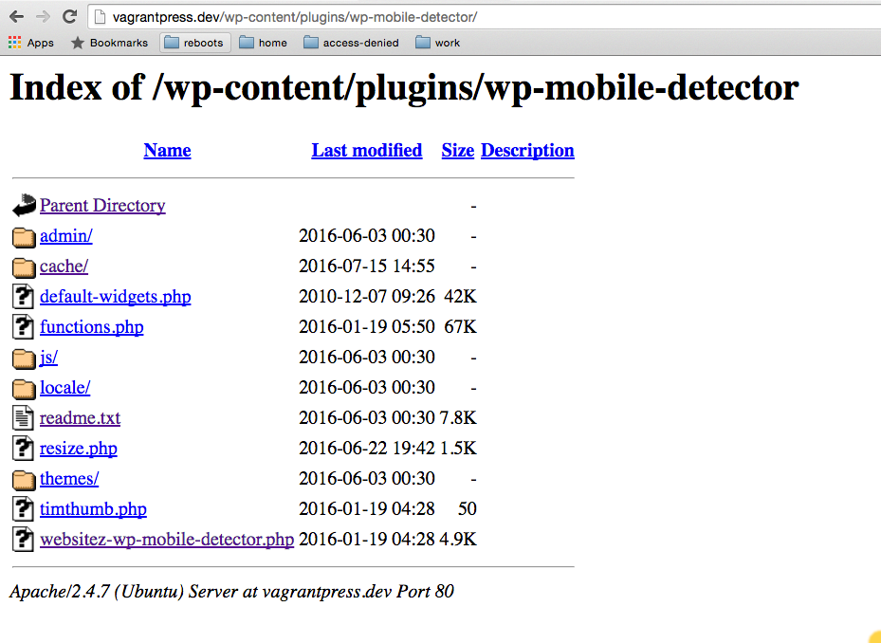

Slide 27
Counter measure
Disable Directory listings
In .htaccess in the root of the site
ask your host to disable in your account
Options -Indexes

Slide 29
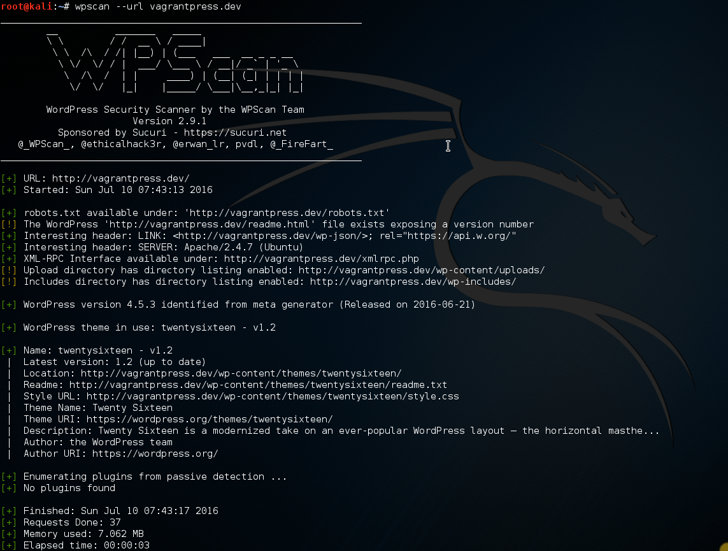

Slide 30
WpScan
Active scan
Scans for signs of vulnerable plugins
Scans for signs of vulnerable themes
Scans for signs of timthumb
Attempts to enumerate user account names
Notes:
Active scan
Scans for signs of vulnerable plugins
Scans for signs of vulnerable themes
Scans for signs of timthumb
Attempts to enumerate user account names

Slide 31
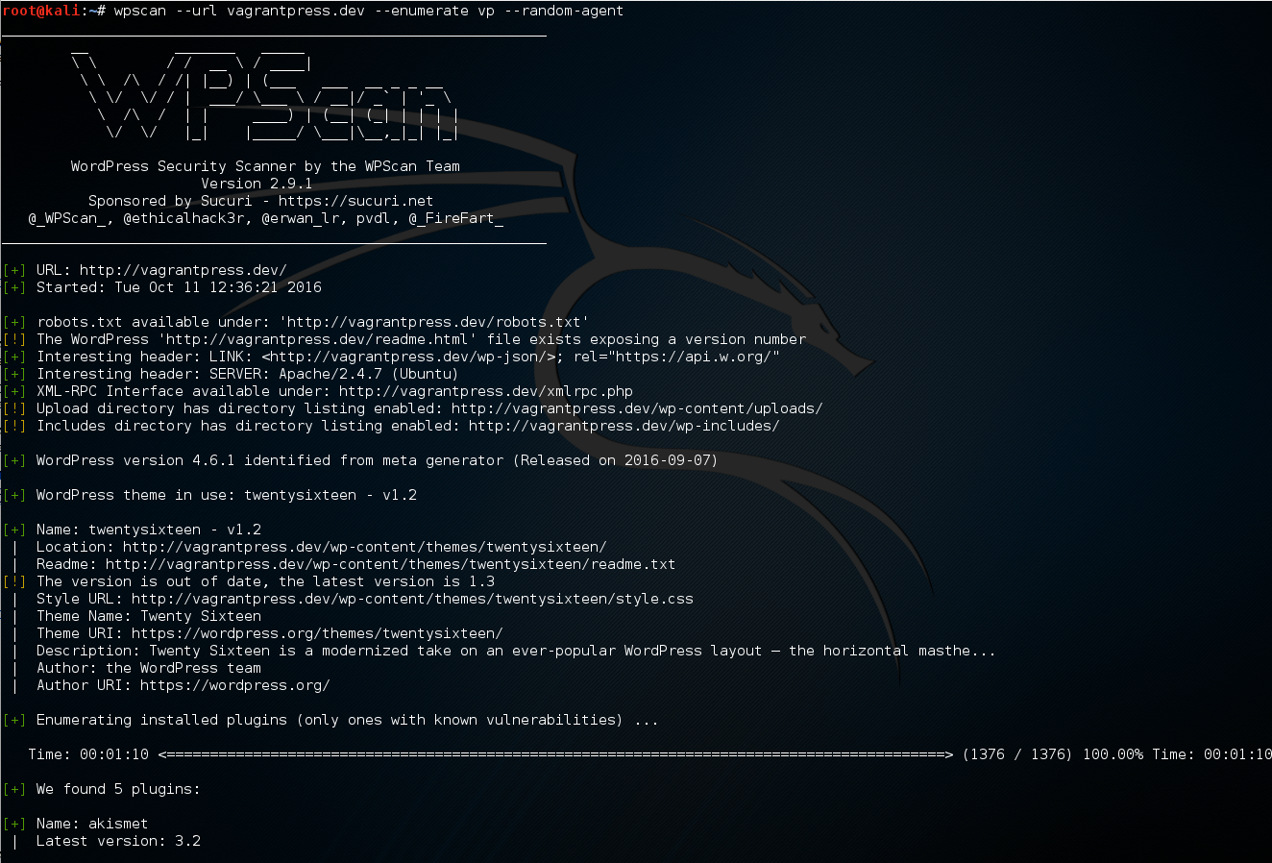


Slide 33
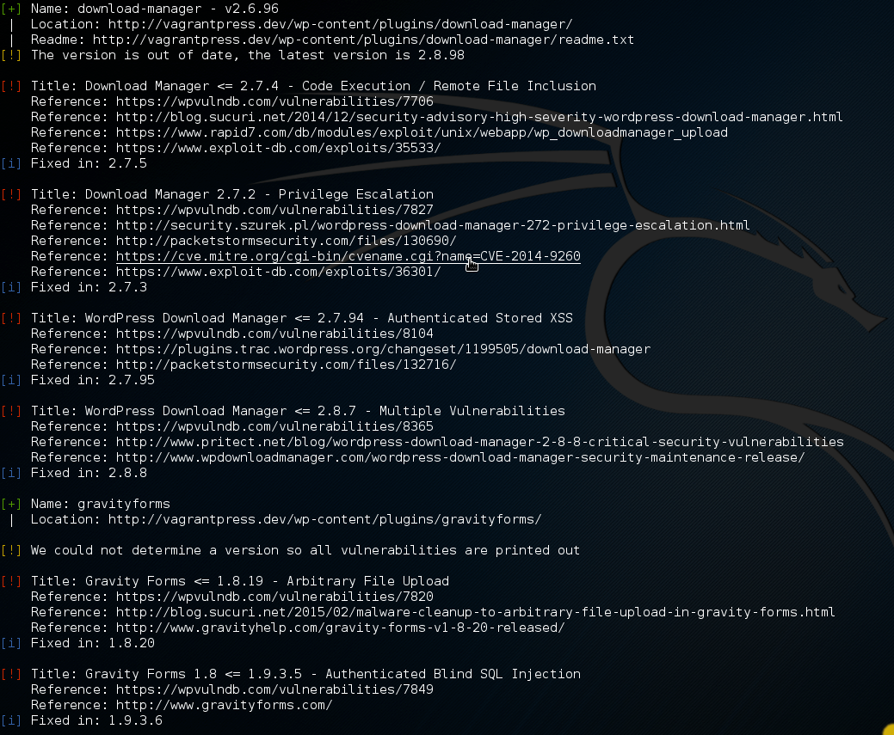
Notes:
CVE - Common Vulnerabilities and Exposures

Slide 34
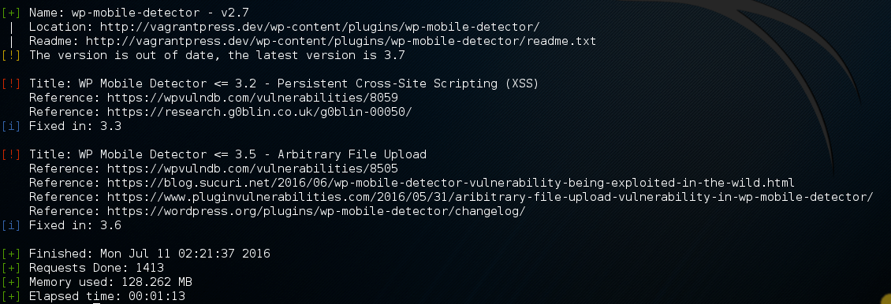

Slide 35
Counter measures
Protect wp-content
Prevent php execution
Notes:
Protect wp-content
Prevent php execution
Implicit deny (only allow what is necessary and expected)
Protect wp-includes
Protect wp-admin
run exploit after showing initial active scan on vagrantpress.dev
do wp-content area first, only blocking php
show how shell wouldn't be accessible, rerun scan
mention how while that blocks execution, can still access read, changeling, etc
next do blocking of everything except white-list, show how everything is blocked but DONT do scan
ask what they think will happen if you run the scan
Add errordocument reroute THEN do scan

Slide 36
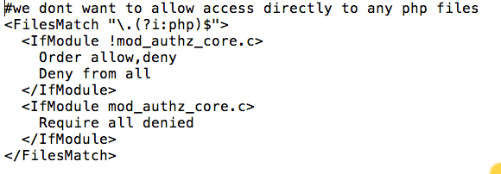

Slide 37
Counter measures
Protect wp-content
Prevent php execution
Implicit deny (only allow what is necessary and expected)
Notes:
Protect wp-content
Prevent php execution
Implicit deny (only allow what is necessary and expected)
Protect wp-includes
Protect wp-admin
run exploit after showing initial active scan on vagrantpress.dev
do wp-content area first, only blocking php
show how shell wouldn't be accessible, rerun scan
mention how while that blocks execution, can still access read, changeling, etc
next do blocking of everything except white-list, show how everything is blocked but DONT do scan
ask what they think will happen if you run the scan
Add errordocument reroute THEN do scan

Slide 38
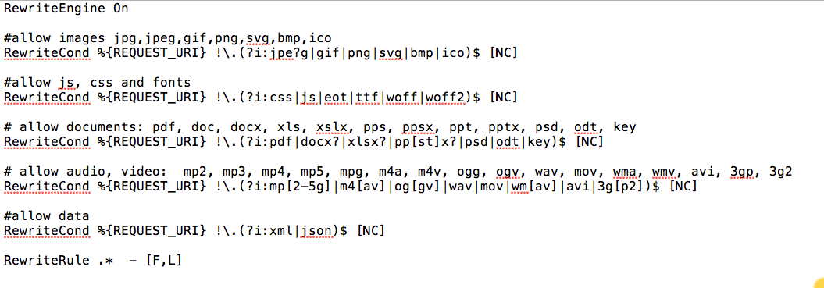

Slide 39
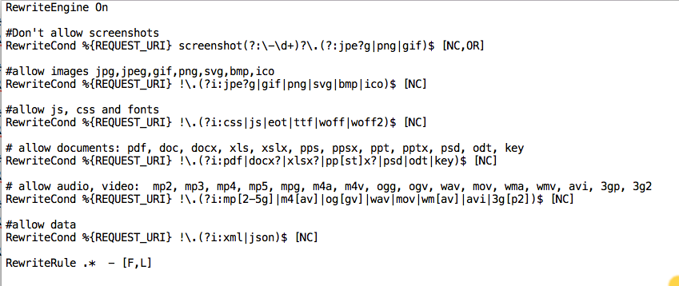

Slide 40
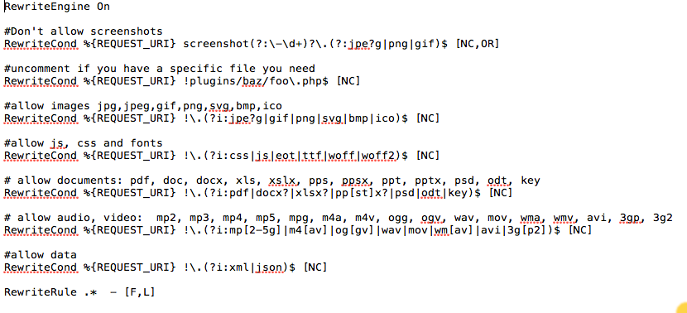

Slide 41
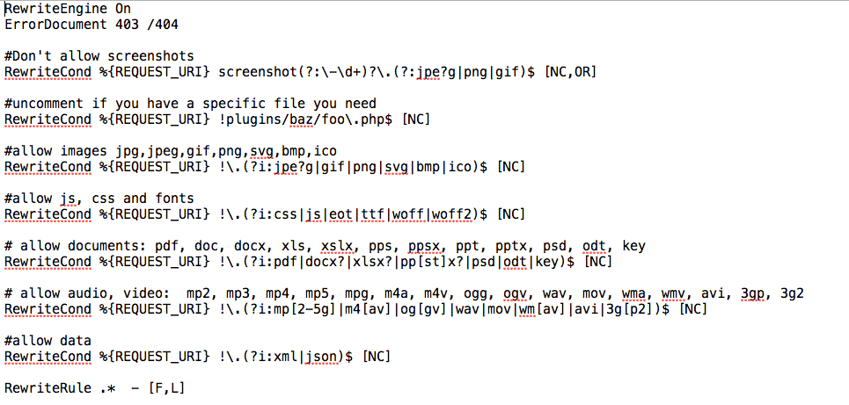


Slide 42
Counter measures
Protect wp-content
Prevent php execution
Implicit deny (only allow what is necessary and expected)
Protect wp-includes
Notes:
Protect wp-content
Prevent php execution
Implicit deny (only allow what is necessary and expected)
Protect wp-includes
Protect wp-admin
run exploit after showing initial active scan on vagrantpress.dev
do wp-content area first, only blocking php
show how shell wouldn't be accessible, rerun scan
mention how while that blocks execution, can still access read, changeling, etc
next do blocking of everything except white-list, show how everything is blocked but DONT do scan
ask what they think will happen if you run the scan
Add errordocument reroute THEN do scan

Slide 43
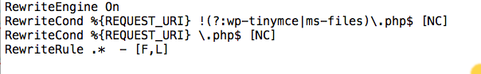

Slide 44
Counter measures
Protect wp-content
Prevent php execution
Implicit deny (only allow what is necessary and expected)
Protect wp-includes
Protect wp-admin
Notes:
Protect wp-content
Prevent php execution
Implicit deny (only allow what is necessary and expected)
Protect wp-includes
Protect wp-admin
run exploit after showing initial active scan on vagrantpress.dev
do wp-content area first, only blocking php
show how shell wouldn't be accessible, rerun scan
mention how while that blocks execution, can still access read, changeling, etc
next do blocking of everything except white-list, show how everything is blocked but DONT do scan
ask what they think will happen if you run the scan
Add errordocument reroute THEN do scan

Slide 45
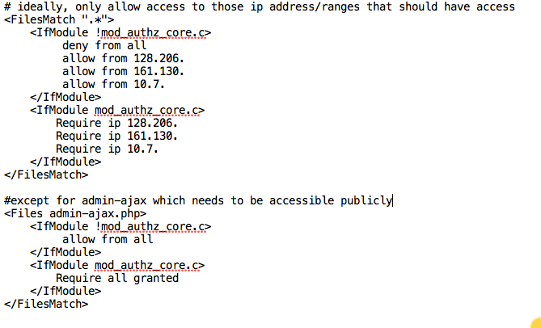

Slide 46
Counter measures
Protect wp-content
Prevent php execution
Implicit deny (only allow what is necessary and expected)
Protect wp-includes
Protect wp-admin
Protect the root
Notes:
Protect wp-content
Prevent php execution
Implicit deny (only allow what is necessary and expected)
Protect wp-includes
Protect wp-admin
run exploit after showing initial active scan on vagrantpress.dev
do wp-content area first, only blocking php
show how shell wouldn't be accessible, rerun scan
mention how while that blocks execution, can still access read, changeling, etc
next do blocking of everything except white-list, show how everything is blocked but DONT do scan
ask what they think will happen if you run the scan
Add errordocument reroute THEN do scan

Slide 47
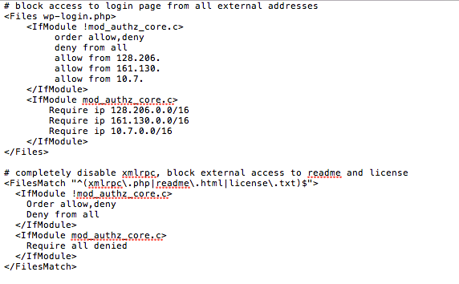

Slide 49
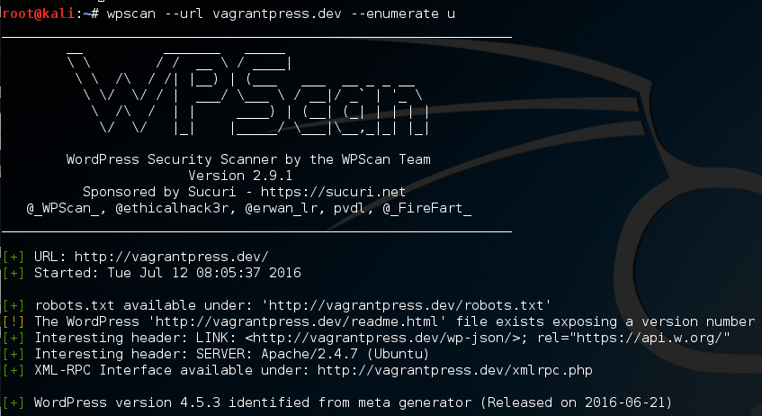
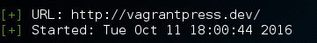
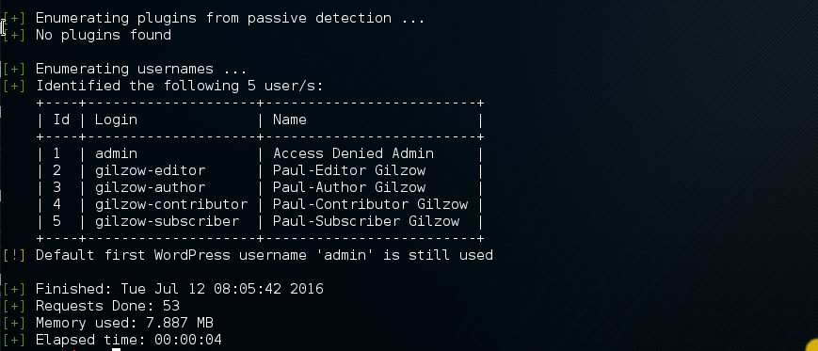
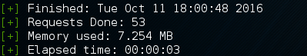

Slide 50
Counter measures
Account enumeration
Prevent ?author= redirection
Notes:
Prevent ?author= redirection
Disable account name as author permalink
Remove author account from classes
Remove default login failure error messages
Debate on whether account enumeration prevention is important
Even more important is strong passwords for every account
Block brute force attempts and mention xmlrpc
also mention that it’s possible for people to log in using email address and email addresses are EVERYWHERE, especially in education
Mention using school’s SSOID system

Slide 51
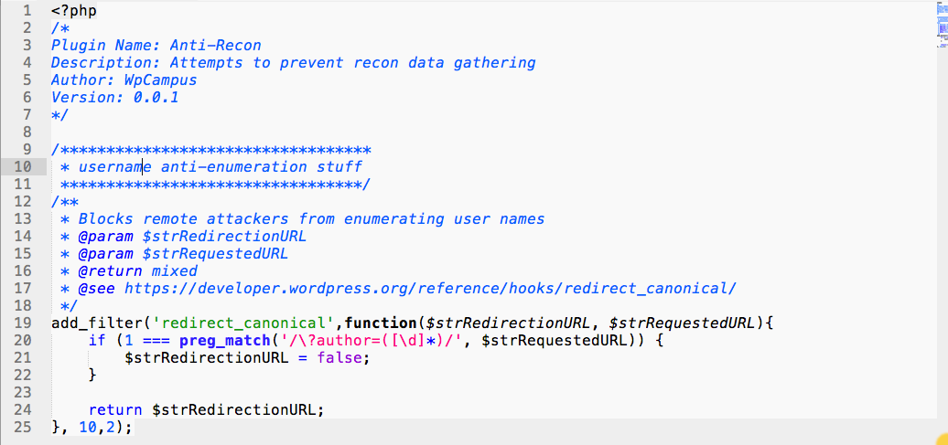

Slide 53
Counter measures
Account enumeration
Prevent ?author= redirection
Disable account name as author permalink
Notes:
Prevent ?author= redirection
Disable account name as author permalink
Remove author account from classes
Remove default login failure error messages
Debate on whether account enumeration prevention is important
Even more important is strong passwords for every account
Block brute force attempts and mention xmlrpc
also mention that it’s possible for people to log in using email address and email addresses are EVERYWHERE, especially in education
Mention using school’s SSOID system

Slide 54
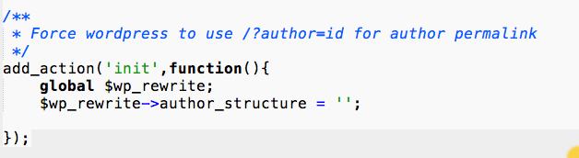

Slide 56


Slide 57
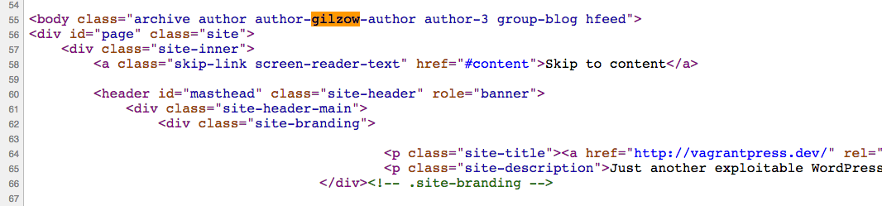

Slide 58
Counter measures
Account enumeration
Prevent ?author= redirection
Disable account name as author permalink
Remove author account from classes
Notes:
Prevent ?author= redirection
Disable account name as author permalink
Remove author account from classes
Remove default login failure error messages
Debate on whether account enumeration prevention is important
Even more important is strong passwords for every account
Block brute force attempts and mention xmlrpc
also mention that it’s possible for people to log in using email address and email addresses are EVERYWHERE, especially in education
Mention using school’s SSOID system

Slide 59
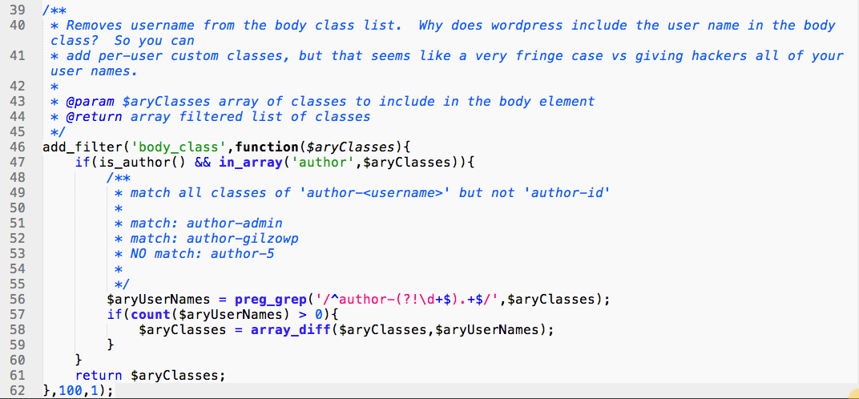

Slide 61
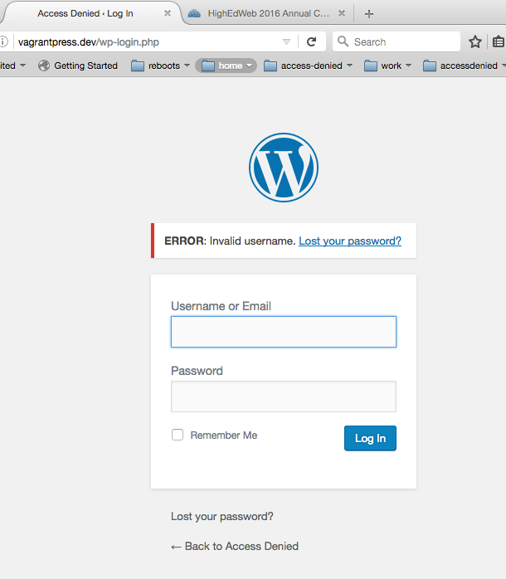

Slide 62
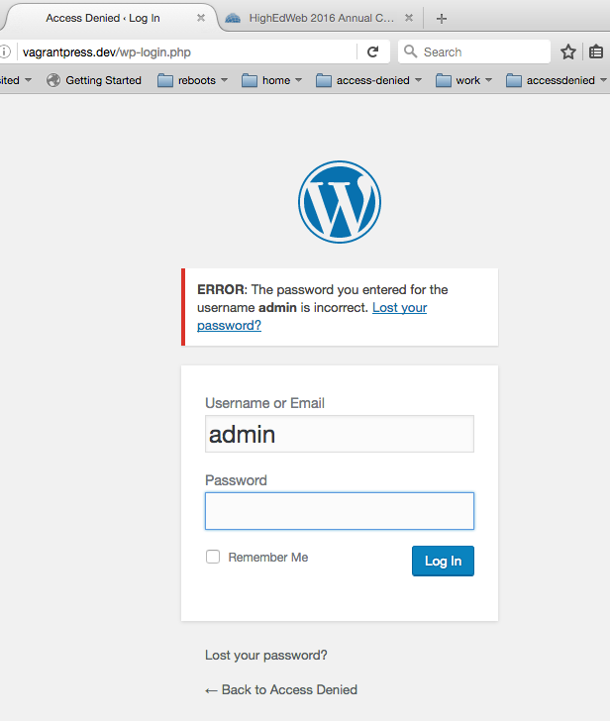

Slide 63
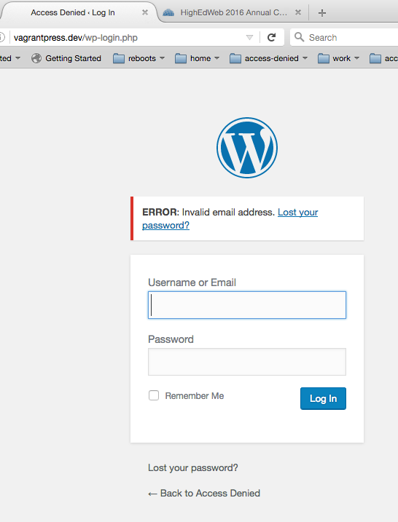

Slide 64
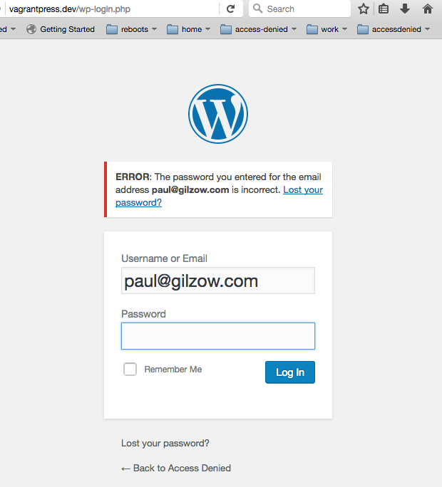

Slide 65


Slide 66
Counter measures
Account enumeration
Prevent ?author= redirection
Disable account name as author permalink
Remove author account from classes
Remove default login failure error messages
Notes:
Prevent ?author= redirection
Disable account name as author permalink
Remove author account from classes
Remove default login failure error messages
Debate on whether account enumeration prevention is important
Even more important is strong passwords for every account
Block brute force attempts and mention xmlrpc
also mention that it’s possible for people to log in using email address and email addresses are EVERYWHERE, especially in education
Mention using school’s SSOID system

Slide 67
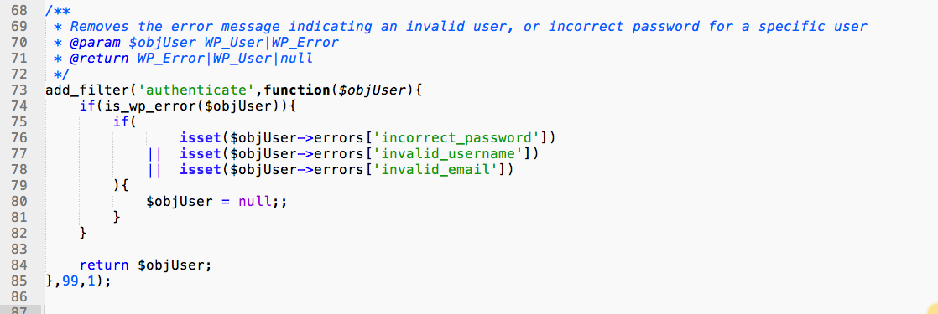

Slide 68
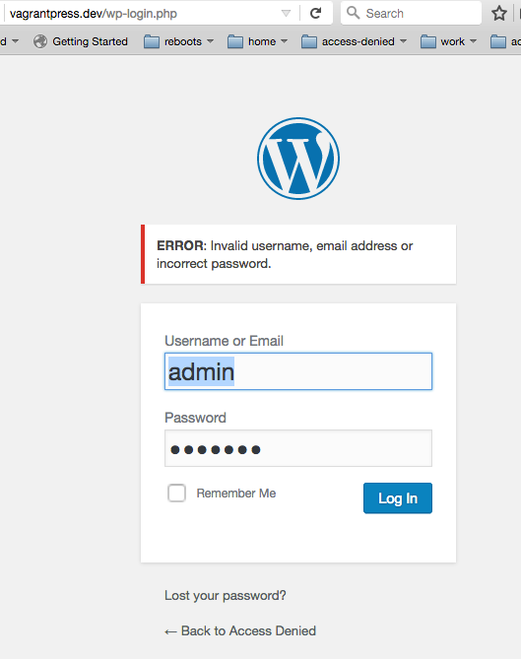

Slide 69
Counter measures
Account enumeration
Prevent ?author= redirection
Disable account name as author permalink
Remove author account from classes
Remove default login failure error messages
User your school’s SSOID system
Notes:
Prevent ?author= redirection
Disable account name as author permalink
Remove author account from classes
Remove default login failure error messages
Debate on whether account enumeration prevention is important
Even more important is strong passwords for every account
Block brute force attempts and mention xmlrpc
also mention that it’s possible for people to log in using email address and email addresses are EVERYWHERE, especially in education
Mention using school’s SSOID system

Slide 70
additional Counter measures
Limit access to wp-login.php and /wp-admin/
Disable file editing
Lock down wp-config.php
Limit or disable xmlrpc
Hide wordpress version
if(!defined('DISALLOW_FILE_EDIT')){
define('DISALLOW_FILE_EDIT', TRUE);
}
Notes:
xmlrpc
- ddos attacks
- bruteforce
directories
find /path/to/your/wordpress/install/ -type d -exec chmod 755 {} \;
files
find /path/to/your/wordpress/install/ -type f -exec chmod 644 {} \;

Slide 71
More extreme Counter measures
Use suPHP, php-fpm
Prevent php from being able to write to files
Move wp-config.php
Move plugin and theme locations
Notes:
xmlrpc
- ddos attacks
- bruteforce
directories
find /path/to/your/wordpress/install/ -type d -exec chmod 755 {} \;
files
find /path/to/your/wordpress/install/ -type f -exec chmod 644 {} \;

Slide 72
additional things to consider
Log everything and analyze those logs

Slide 73
Counter measures
Make sure you have directory listing disabled
Prevent PHP execution where it shouldn’t happen
User account names
XML-RPC

Slide 74
Summary
Be paranoid; be skeptical
Uninstall plugins/themes that aren’t in use
Disable php from executing where it shouldn’t
Limit access to everything where you can

Slide 75
“[Security is a] continuously moving target… that requires constant vigilance to understand and appreciate.”
Tony Perez, @perezbox
Notes:
what we cover/discuss today might not be relevant next year

Slide 76
With ease of use and extensibility, comes a responsibility.
Tony Perez, @perezbox

Slide 77
questions?
Contact
gilzow@missouri.edu
@gilzow on twitter
Files: https://github.com/gilzow/access-denied/
Join #WPCampus! wpcampus.org
Find Curtiss Grymala for a free sticker!

